Slide 2
GROWING
YOUNG ADULTS
INTO CHURCH LEADERSHIP

Slide 3
“I think the responsibility of leadership in the church is not to do slick meetings and not to figure out how to get 5,000 people through a facility in a weekend. It is to produce a people like Jesus. Let’s be a people who are actually producing something on the ground that could totally annihilate the enemy in our city. That’s our job!”
Graham Cooke

Slide 4
“…data from the 2021 census, released by the Australian Bureau of Statistics … shows that just 44 per cent of Australians now identify as Christian, down from 52 per cent five years earlier and 61 per cent in 2011.
SMH - June 28, 2022
Notes:
Sydney Morning Herald
For comparison - in the 1960’s less than 1% of Australians identified as non-religious.
The church needs Christ like leaders more than ever before!
This next slide may not connect with some of us ‘older folks’ - but this workshop is about helping our YA into church leadership. To help them we need to have an understanding of the world they are living in.

Slide 5
“Our secular society promises us that we can find ultimate meaning and purpose as we look within ourselves. Self-discovery -”finding our authentic self-”can provide every resource needed to achieve fulfilment and happiness. Anything that restrains self-fulfilment is a threat to individual and social wellbeing. This stands in stark contrast to the words of Jesus, who declared that anyone who wanted to be his disciple and see life in the age to come must deny themselves and take up their cross (Luke 9 v 23).”
Stephen McAlpine - Future Proof, 2024
Notes:
May young adults are very judgemental - seeing themselves and their beliefs as correct.
The church has done itself a great disservice over the past few years with church scandals, here in NZ and abroad, Pastor scandals, pastor and priest abuse.
When society is telling me I can find ‘ultimate meaning and purpose’ within myself, and the church appears to be evil and falling apart - why would I stay in church?
In asking a number of pastors and workers with youth and young adults they continue to highlight several issues they see in their youth and young adults.

Slide 6
-Anxiety!
-Identity
-LGBTQ+
-Societal divisions
-What is a Christian
-Pornography
-Mental and emotional health
-Digital Natives
Notes:
-Anxiety -
“…we are facing a tsunami of anxiety, especially among younger people, and especially around matters of meaning and purpose in life. Something is not working. Something is broken. The rates of worry and depression we are experiencing are off the charts. This anxiety wave is backed up by the research. The Australian Bureau of Statistics announced that in 2022 one in five Australians was suffering from a mental-health disorder, with young women the most affected by anxiety. Dr Zena Burgess, the CEO of the Australian Psychological Society, declared that “Anxiety is sweeping through the country at unprecedented rates across all ages, but especially children, young people and women.” Stephen McAlpine
-Identity - Who am I. Even deeper - what is a person? What is a man. What is a woman etc.
-LGBTQ+ - How do I engage with the rainbow community that is all over my school and university etc? My church is not talking about this, yet it is everywhere in my world.
-Societal divisions - Political, Gender, Immigration, Church beliefs…
Mark Sayers - key Christian speaker on Culture and Christianity sees this growing polarisation on issues as a key destructive trend in society and in the church.
-What is a real Christian. - What does it mean to be a disciple of Jesus. Do I truly see Jesus in my leaders.
-Pornography- we all know it is only a click away on their - and our phones. One study I was reading argued the ‘common’ porn is morphing into much more violent and dangerous porn as people look for a newer and harder hit. And I’m Sure you know - but most of our youth and young adults knows how to get around most of the blockers we have on their phones.
-Mental and emotional health- It is everywhere - me and/or all my friends.
-Digital Natives - Most of them have not know a time when they were not online - SM in its various forms is a natural part of their life. This is controversial - but an example is ‘a transgender influencer living in NYC can have a more significant impact on your youth or young adults living in kihikihi’ than their parents, teachers or youth pastor. And for them this is normal!
A simple question here is - how are you addressing these issues with your young adults - and youth? If we are not talking about them, we are allowing society - friends, social media - to address these issues most probably in an unhealthy, unbiblical way.
Tim keller…

Slide 7
“The modern self is exceptionally fragile. While having the freedom to define and validate oneself is superficially liberating, it is also exhausting: You and you alone must create and sustain your identity. This has contributed to unprecedented levels of depression and anxiety and never-satisfied longings for affirmation.”
Tim Keller, The Atlantic, 2023
Notes:
This is a workshop - not a lecture - so GAF and discuss this for a minute.
It really isn’t a matter of ‘do you agree with this’ as this in the reality for many - not all - our YA. But more -what do we do with this in the church?
OK - I wanted to give a quick overview of where some of our young adults are living atm, as for many of us this is not our world.
In saying all this then - the question of leadership development is significant!

Slide 8
1. What is
Christian Leadership?
Notes:
Godly Christian leaders who know who they are in Christ and know the Word of God - are needed ore than every before!!!
Obvs before we talk about ways to build our youth and YA up into Ch leadership need to define it.
So…

Slide 9
Discuss:
How do you define Christian leadership?
Notes:
So many definitions - here is a simple one I use.

Slide 10
Helping people become more like Jesus
Helping people become more useful for Jesus
Notes:
Basically- its discipleship. Helping them be a better disciple, or follower, or apprentice, to Jesus
OK - lets quickly look at a couple of verses to help define Christian leadership. We’ll go over this super fast as y’all know this already.

Slide 11
Matthew 20:25–28
“But Jesus called them together and said, “You know that the rulers in this world lord it over their people, and officials flaunt their authority over those under them. But among you it will be different. Whoever wants to be a leader among you must be your servant, and whoever wants to be first among you must become your slave. For even the Son of Man came not to be served but to serve others and to give his life as a ransom for many.”

Slide 12
John 13:13-17: This passage illustrates the importance of humility and servitude in leadership, as Jesus washed the feet of His disciples.
Acts 20:28: This verse highlights the importance of shepherding the flock of God, protecting them from harm and leading them in truth.
Ephesians 4:11-12: This passage explains the role of leaders in the church, equipping the saints for the work of ministry, building up the body of Christ.
1 Peter 5:1-3: This verse encourages leaders to be examples to the flock, exercising their leadership with humility and gentleness.
James 3:1: This verse cautions against the dangers of becoming a teacher or leader, emphasizing the importance of being careful with one's words and actions.
Notes:
So many verses on Leadership. And I’m proposing - arguing :) - that the core of leadership is discipleship - becoming like Jesus.

Slide 13
John 13.34-35
“So now I am giving you a new commandment: Love each other. Just as I have loved you, you should love each other. Your love for one another will prove to the world that you are my disciples.”
Jesus leadership style is…
Notes:
Putting this in a biblical context- the main call on the church is Matt 28 - gt commission. Core of that is to make disciples.
Discuss -next page
Photo by <a href="https://unsplash.com/@daniquegodwin?utm_content=creditCopyText&utm_medium=referral&utm_source=unsplash">Danique Godwin</a> on <a href="https://unsplash.com/photos/person-wearing-brown-hiking-sandals-TK-n2evDzwg?utm_content=creditCopyText&utm_medium=referral&utm_source=unsplash">Unsplash</a>

Slide 14
John 13.34-35
Jesus leadership style is…
Discuss - what has Jesus just done, what is he about to do?
What would be 4-5 words you would use to describe Jesus leadership style?
Notes:
read the verses - what has he just done, what is he about to do?
-just washed the D’s feet - humility and service!
-is about to go to the cross - humility (Phil 2) and sacrifice.
Humility, sacrifice, service.
Yes he taught the disciples about God (i.e. we should be teaching people the bible), but the key he seems to teach them is humility, sacrifice, service and he does this through teaching bu also through modelling.
There is a wild aspect to christian leadership at the beginning of the book of Joshua.
Photo by <a href="https://unsplash.com/@daniquegodwin?utm_content=creditCopyText&utm_medium=referral&utm_source=unsplash">Danique Godwin</a> on <a href="https://unsplash.com/photos/person-wearing-brown-hiking-sandals-TK-n2evDzwg?utm_content=creditCopyText&utm_medium=referral&utm_source=unsplash">Unsplash</a>

Slide 15
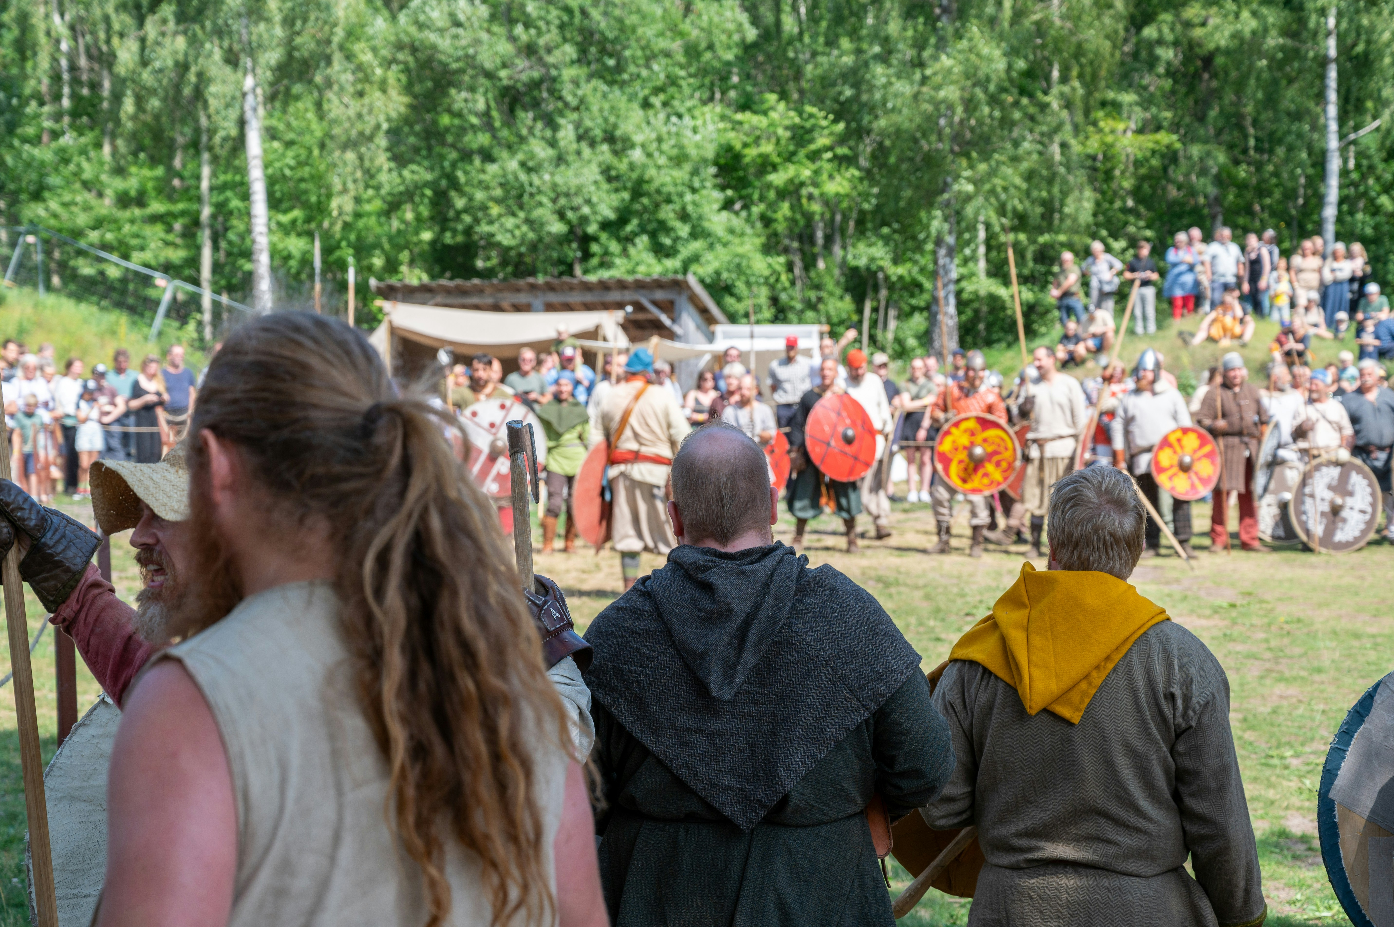
Joshua 1.6-9
“Be strong and courageous, for you are the one who will lead these people to possess all the land I swore to their ancestors I would give them. Be strong and very courageous. Be careful to obey all the instructions Moses gave you. Do not deviate from them, turning either to the right or to the left. Then you will be successful in everything you do. Study this Book of Instruction continually. Meditate on it day and night so you will be sure to obey everything written in it. Only then will you prosper and succeed in all you do. This is my command—be strong and courageous! Do not be afraid or discouraged. For the Lord your God is with you wherever you go.”

Slide 16
Joshua 1.6-9
Discuss - what is the key to Joshua’s success?
- what is God calling him to be successful in?
Notes:
Bible - such a weird passage - unless the bible really is the word of almighty God and really does connect us with God.
God is calling him to be successful in LEADING the people of God into conquering the land of Israel.
So we put these two aspects together.
-the leadership of Jesus is so much about modelling - humility, sacrifice, service
-leadership is grounded in the bible.

Slide 17
Discuss
Can Christian leadership, then, be defined as a form of discipleship?
(Feel super free to disagree 😂)
Notes:
In one sense - yes. That is all it is.
In another - although I’m discipling them - I am wanting to see them develop their leadership skills and gifting - more on this shortly.
So -when I think about developing young adults for leadership - I’m thinking much wider than simply - developing them to lead a ministry, or a future elder etc.
What does it look like for me to develop them in their relationship with Christ first and foremost!
Isn’t becoming like Jesus the greatest calling someone can have on their life?
Out of that will flow the fruit of the spirit
Out of that will flow the gifts of the spirit and then I will see them desire to step up to lead (although shoulder tapping is vital :)
Photo by <a href="https://unsplash.com/@jonnysplsh?utm_content=creditCopyText&utm_medium=referral&utm_source=unsplash">Jonny Caspari</a> on <a href="https://unsplash.com/photos/person-hand-on-grass-land-DVzt7cvRKRo?utm_content=creditCopyText&utm_medium=referral&utm_source=unsplash">Unsplash</a>
Photo by <a href="https://unsplash.com/@robertwalsh0?utm_content=creditCopyText&utm_medium=referral&utm_source=unsplash">rob walsh</a> on <a href="https://unsplash.com/photos/person-hand-holding-paper-4lfrwRyHRYk?utm_content=creditCopyText&utm_medium=referral&utm_source=unsplash">Unsplash</a>

Slide 18
“There is no such thing as a self-made spiritual leader. A true leader influences others spiritually only because the Spirit works in and through him to a greater degree than in those he leads.”
J. Oswald Sanders
Notes:
So powerful. We must be as much like Jesus as we possibly can!

Slide 19
2. Why am I even doing this?
Notes:
This is simply a good question to ask in general, and before you approach each young potential leader.
-Is it to fill a hole in ministry?
OR -Is it to honestly grow the person to be more like Jesus?
I do think one of the problems some churches have is they wait until a person believes exactly what ‘they’ believe before they are ready to grow them in ministry leadership.
Illustration:
A pastor friend of mine believes it is important to belong before you believe. Many churches it is the other way around - explain!
So, a new person will arrive at church and he’ll chat with them - see they are interested in tech for example and ask if they could help with tech that Sunday. The tech team knows to expect this and….Belonging!!!!!

Slide 20
Discuss -Which is better?
-Belief leads to belonging
-Belonging will lead to Belief
-Which of these did Jesus model for us?

Slide 21
3. What is GOD calling them to do?
Notes:
This is a key question that needs to happen early on.
Initially this may simply be a call to disciple someone. .
How do we - me and them - figure out what God is calling them into - leadership or whatever?

Slide 22
I may have lots of good ideas for them. The key is for me and them to hear from God!
God needs to make His vision for them clear so we can work together towards that vision!

Slide 23
a. Pray for them
Notes:
Not rocket science - I’m sure you do this anyway - but if I didn’t start here Jackie the prayer enabler for CCCNZ would tell me off.
Before you do anything I’d encourage you to be praying for them.
Your idea or plan for them could be completely wrong - only God knows what is best for them.
These next few points are obvious so I will zip through them.

Slide 24
b. What is their calling:
-Dreams, desires, passions
Notes:
Often they have no idea - which is super frustrating.
So keep praying, and keep discipling them, and keep asking them what they believe God is laying on their heart.
The church has a terrible history of just finding people to fill a hole in ministry. This is not God honouring as I’ll talk about shortly. And, this can so set people up to fail if God is not in this.
Illustration: You may know I used to work at a Bible College. Many interns we had took the first 6 months of the year in significant ministry hours to figure out what God was really calling them to do. Those first 6 months were very hard as they tried this and that and failed here, and hated this here.
A friend of mine was basically pushed into kids ministry when they were old enough to lead a sunday school class. Although they loved the kids, they were not equipped or gifted by the spirit for this ministry. They hated every Sunday!
I’ve had young friends tell me the first time they preached they were literally given a passage and told to preach on it next Sunday - no help or guidance or prayer. And - suprise surprise - the sermon was terrible, they were embarrassed and never wanted to preach again!
We’ll talk shortly about short term ministry trials.

Slide 25
c. What is their Spiritual Gifting?
Romans 12.8
Notes:
Its not hard todays to figure out someones spiritual gifts. There are so many gifting courses.
After praying and talking about their dreams, ask them to do a gifting course and then - key - talk through all this carefully with them.
Illustration: We did a gifting course with our whole church at Agora back in 2021, as I’m sure you all have done with your church. We preached through each of the gifts, and had workbooks that covered some personality info and the dreams desires stuff.
The key we wanted to do to land it though fell apart due to the pandemic :(
We wanted to do a consultation with each person or couple by an elder and their spouse.
We’d set everything up and ended up with a good number of people keen - and then we hit that long lockdown at the end of 2022. Frustrating. When we got out of lockdown the momentum was lost. We still did a few consultations casually - but striking while that excitement was there was the key.
The consultation is simply sitting with the people to put all this together - and nail down exactly where in the church or community they might be gifted and called to serve.
A key to note here is that there is a spiritual gift of Leadership. I’m sure you know the Romans 12.8 verse. We are all called to lead in various capacities, but some are gifted by the Spirit to lead.
In allowing the Spirit to lead here you, and they, will see where the Spirit is leading them to.
Remember - I argued this is more about discipleship than ‘just’ developing a leader for a ministry or eldership etc.

Slide 26
“Christians everywhere have undiscovered and unused spiritual gifts. The leader must help bring those gifts into the service of the kingdom, to develop them, to marshal their power. Spirituality alone does not make a leader; natural gifts and those given by God must be there too.”
J. Oswald Sanders

Slide 27
Discuss:
-Why do many young adults have no idea what God is calling them to do?
-How has your church led everyone through growing in their spiritual gifts?
Notes:
-ok
Pray
Dreams, desires etc
Spiritual gift.

Slide 28
d. Do it
Fruit, Fulfilment
Notes:
Simple - you need to give YA SAFE opportunities to serve.
This is kind of obvious, so here are a couple of thoughts on this.
Have you considered what level you are developing the person for. There is a significant difference - obviously - in developing someone to be a SG leader, an Elder, a women’s ministry leader, a pastoral carer. Some of these need specific training - which we’ll get too.
What are the SAFE opportunities you have for them to serve in?
They may fail!
Fruit and fulfilment.
Fruit - does it work. Do the people they are ministering to experience the fruit of the spirit working through the person.
Fulfilment - does the person serving experience joy in the Spirit as they serve?
This means everything from ensuring there is a review of their serving, and clearly it is not forever.
Illustrations: 2 things we did at Agora here
We invite young adults, and others to serve on Sunday in different speaking roles. It starts with asking them to read Scripture, then if they do well in that, We’d ask them to bring the open or close to the service. If that goes well we’ll ask them to maybe intro communion with some help around preparing their thoughts. And so on.
Our children’s pastor and I were designing 3 SAFE sunday children’s ministry experiences. This was - he would meet with them before they came to serve if this was an area we and they had identified as a passion, gifting etc of theirs. Then they would serve three Sundays with a v light discussion/review after each sunday, then a more formal review after the third sunday. The plan was people would know this was just for three Sundays, and involved careful review.

Slide 29
Discuss:
What are some ways you have ‘safe’ ministry opportunities?

Slide 30
3. What are some CCCNZ/OBH churches doing?
Notes:
There are a lot of our churches already doing various levels of leadership development among YA.
Some of these have more formalised plans, and some are quite ‘organic’. The key I heard when asking our churches how they do this is - we have to have a plan or it never happens. :)

Slide 31
More Formal:
-4 YA - 1 day a week.
-SALT course. -bradcarr.nz
Notes:
-4 YA - this day is a combination of formal study through a bible college, and practical ministry
-Several churches have used Brad Carr’s Salt Course.
One church did this for 6 years and has basically ended up with more leaders than they have positions for :)

Slide 32
Identify committed YA
1-on-1
Invest and equip
Intentional conversations
“First Training”
- Identify committed couples.
Notes:
1-on-1 - many churches simply identify committed YA and begin a mentoring/discipling relationship with them.
Invest and equip. Up skilling in the area they are passionate and gifted about. So many rss around now. Bring them to summits and other training days. Hugely encouraging as they see your desire to invest in them - and a bunch of the up-skilling is done for you :)
Intentional conversations with them - about where to next, prayer and brainstorm with them.
First training.
Let me finish with this quote..

Slide 33
“The first order of things to be changed is me, the leader. After I consider how hard it is to change myself, then I will understand the challenge of trying to change others. This is the ultimate test of leadership.”
John Maxwell

Slide 34
Discuss:
Soooo - what are two or three key actions you need to add to your leadership development?

